Slide 1
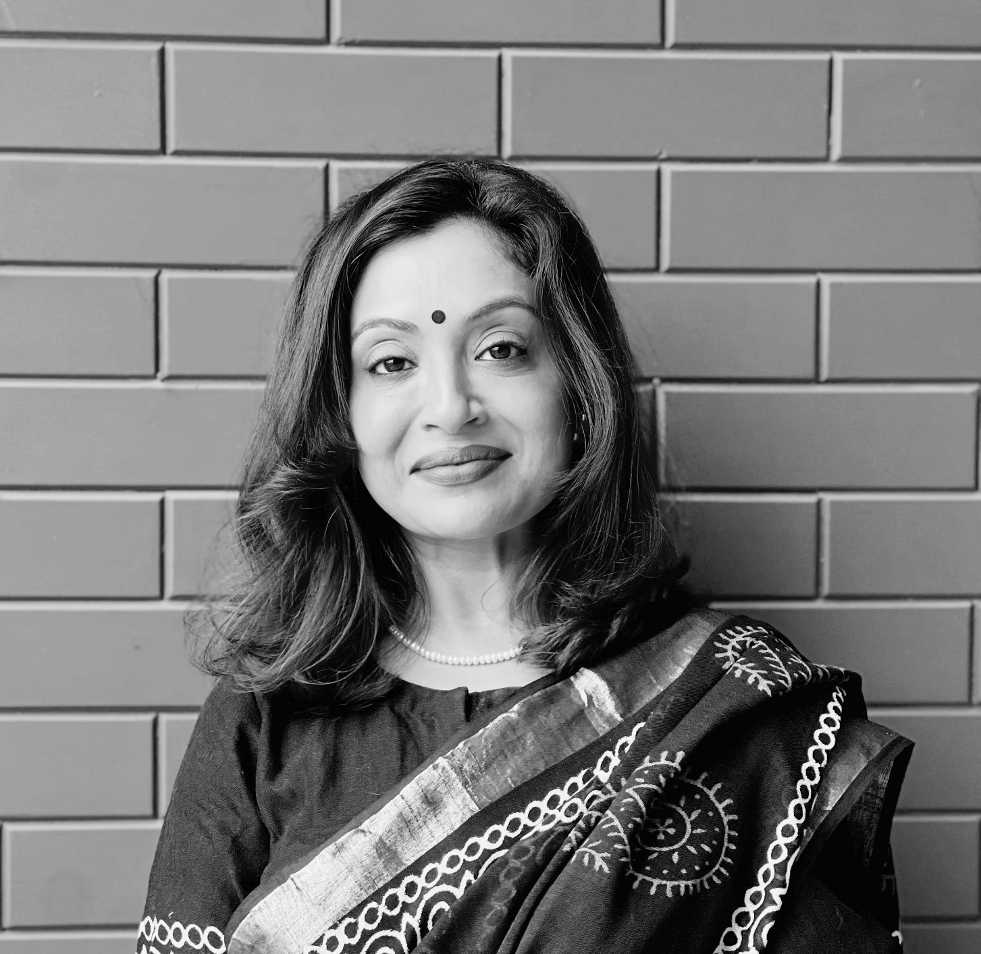






Who are we?
Rennie brings over a decade of management experience from top banks like CitiBank and Royal Bank of Scotland, transitioning to specialize in corporate law in 2015. As the visionary founder of the Aalekh Foundation, she champions vocational training and advocates for water rejuvenation and climate change. With her diverse expertise and commitment to impactful change, Rennie leads ThreeAcross towards inclusive growth and transformative innovation.
Rennie Joyy
Advisory Board

